Slide 1

CommuSA
APTOS-based Modular Distributed Execution Framework

Slide 2
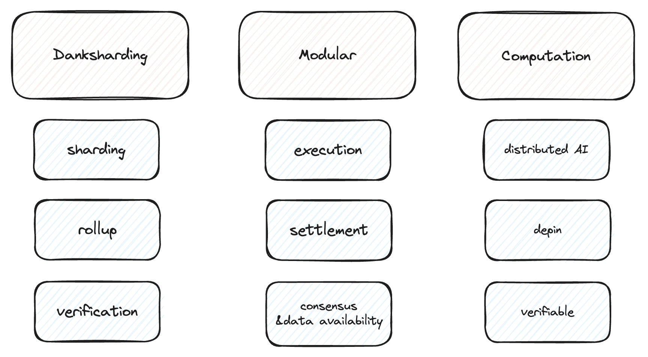
Future Just Happened

Slide 3
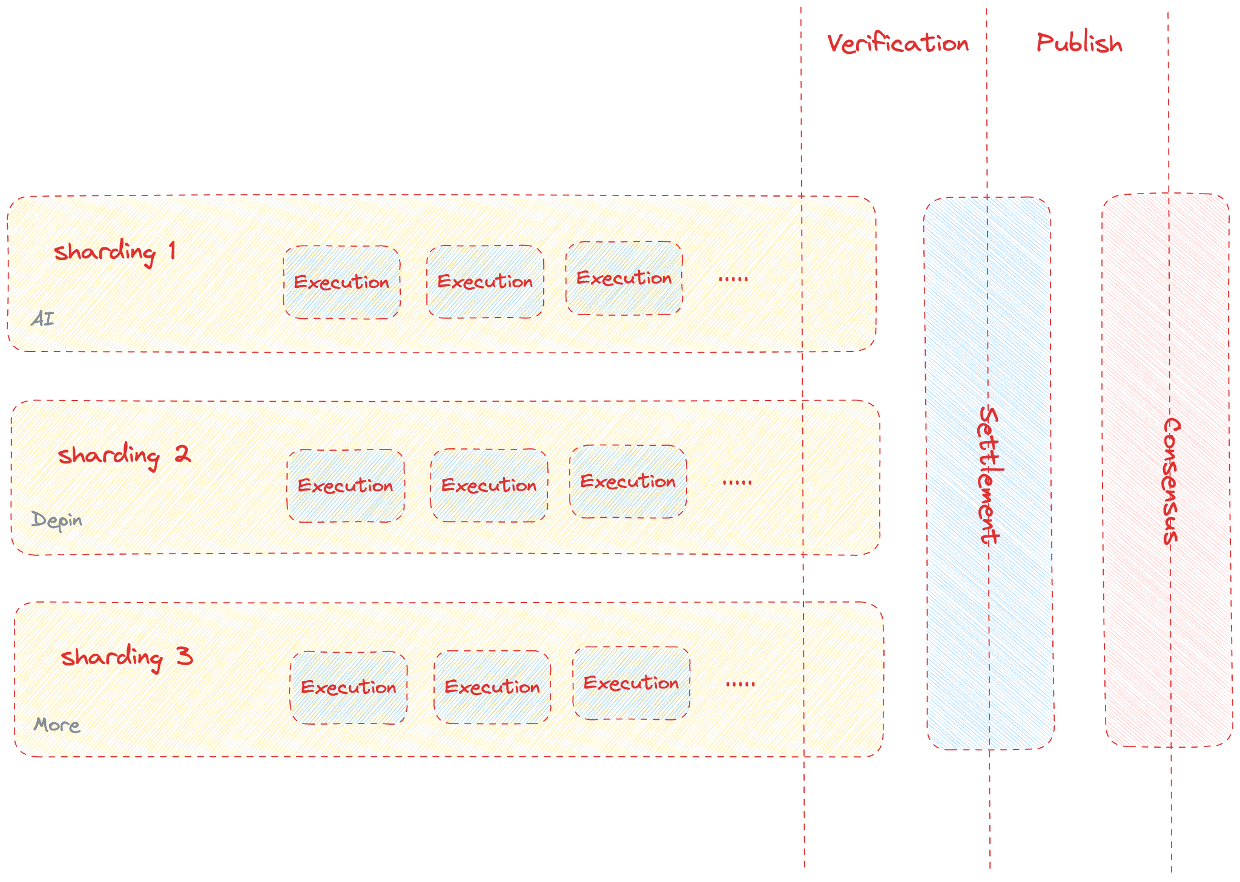
We Got …
# Shardings for verifiable tasks
# Settlement layer for validation and packaging
# Root-Chain for Consensus and Security

Slide 4
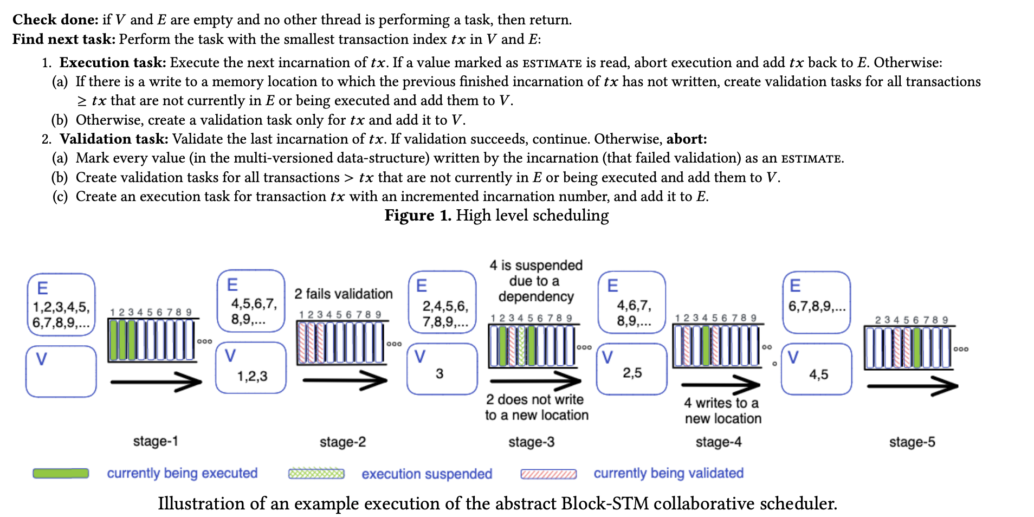
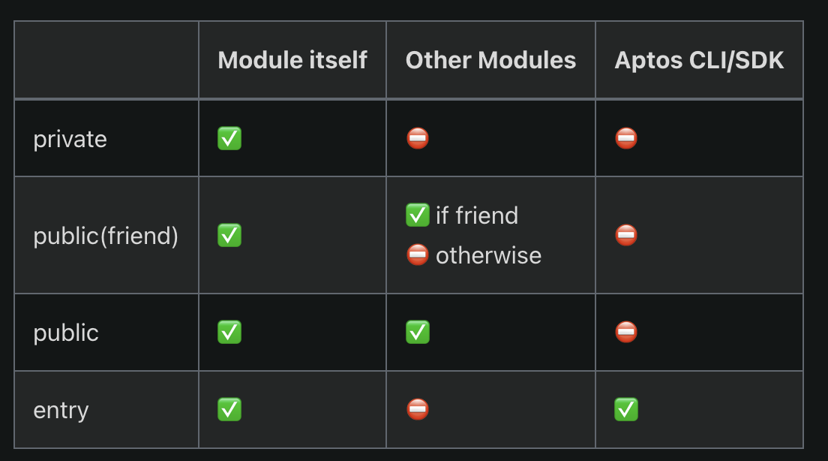
How is Aptos different?
# Access control
# Block-STM collaborative scheduler
flexible key management
parallel transaction execution
support atomicity with arbitrarily complex transactions,
Modular

Slide 5
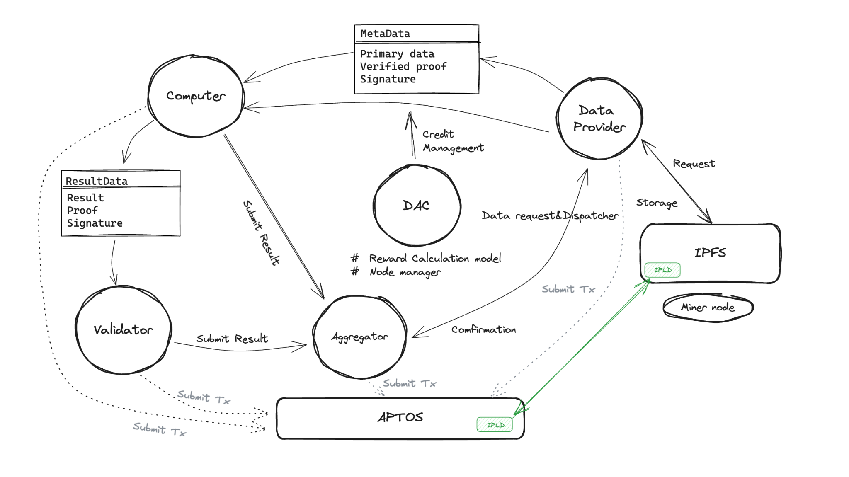
Parallel computing Actor

Slide 6
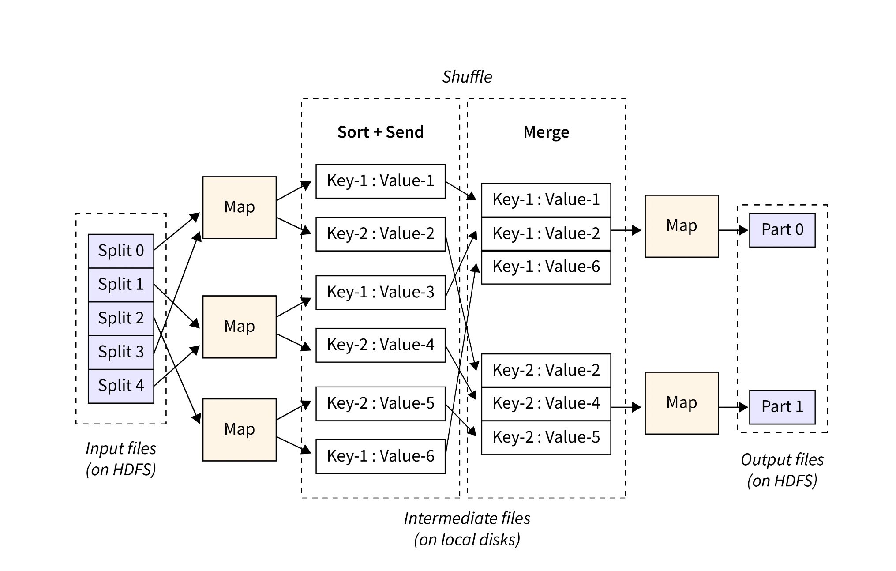
MapReduce
MapReduce is a programming model for large-scale data processing that enables parallel computing and data processing by decomposing the task into two phases, Map and Reduce.

Slide 7
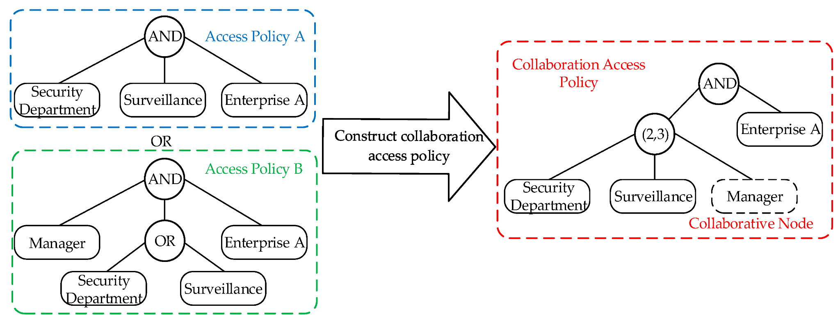
Access Control
We chose to use ciphertext-policy attribute-based encryption (CPABE) as the access control algorithm

Slide 8
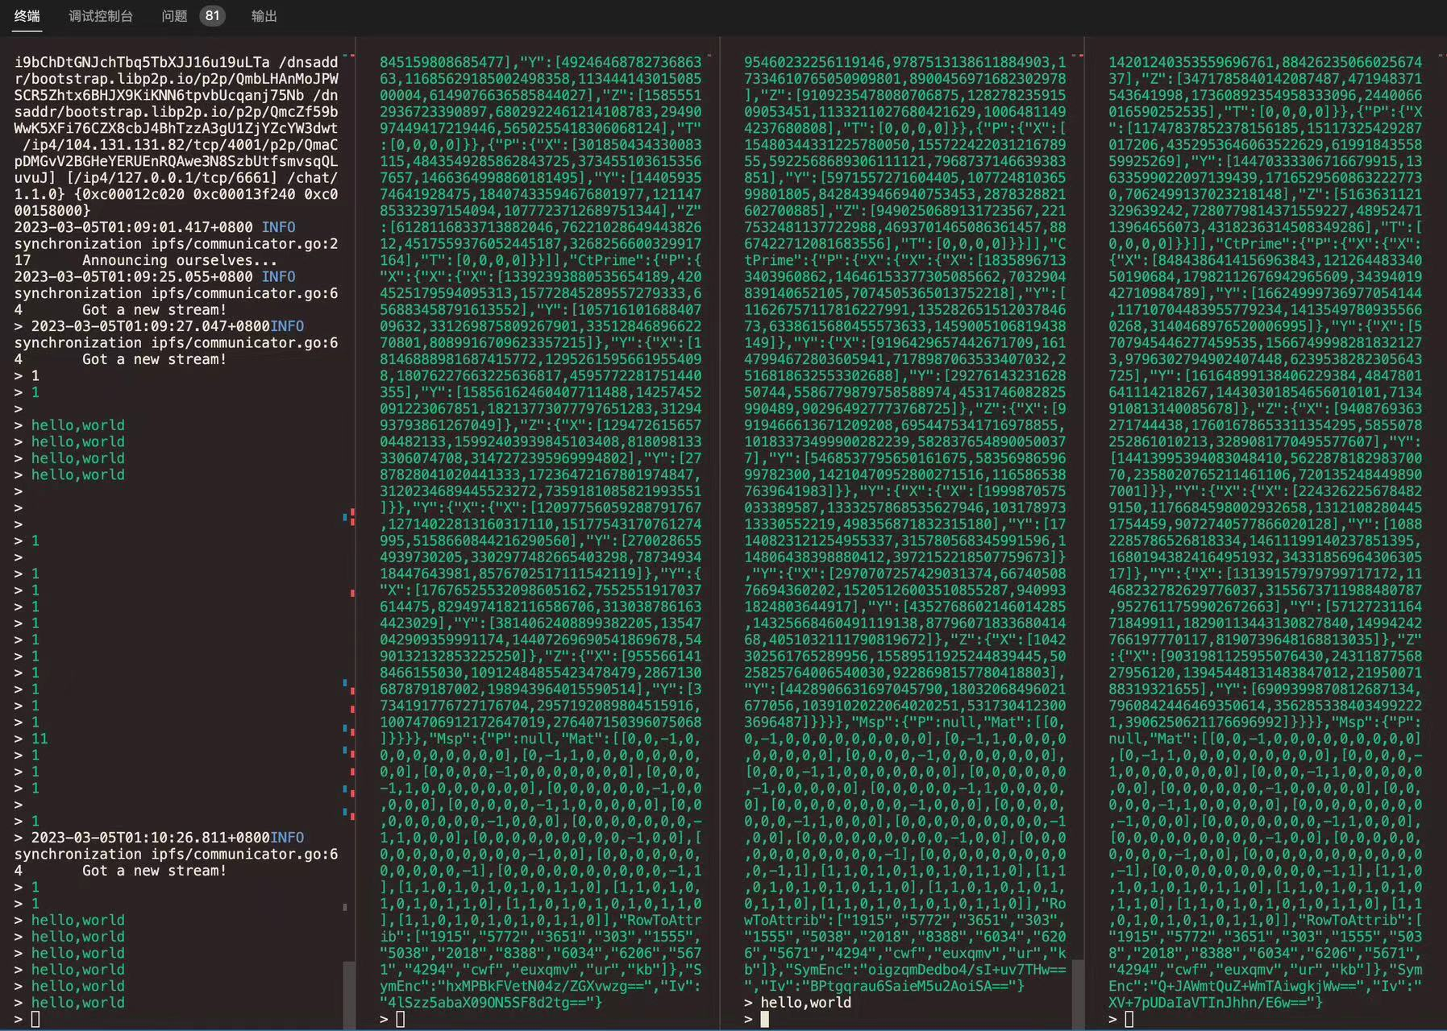

Slide 9
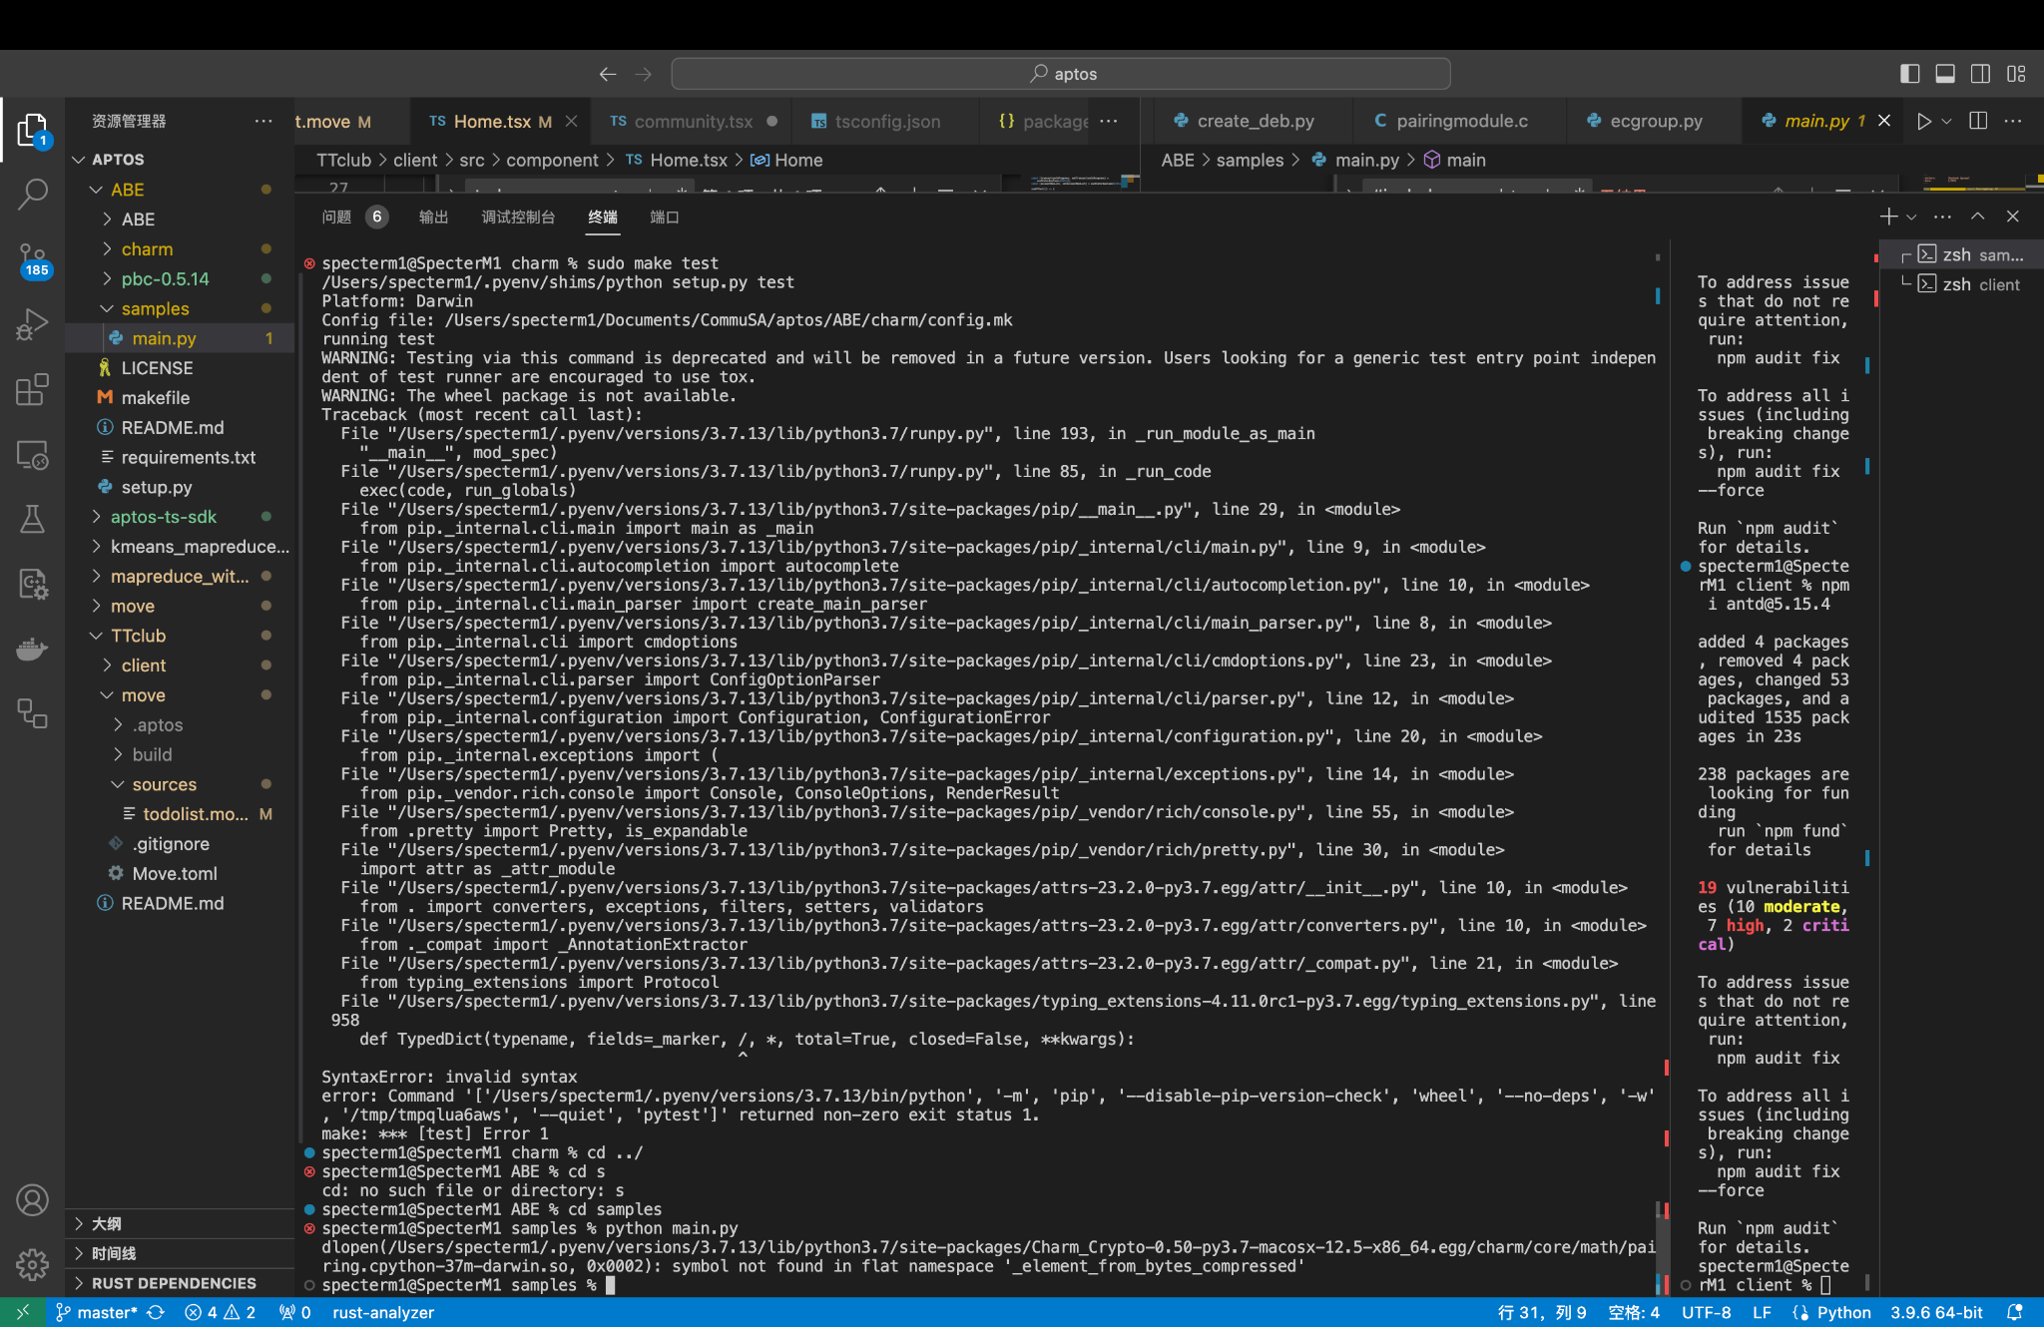
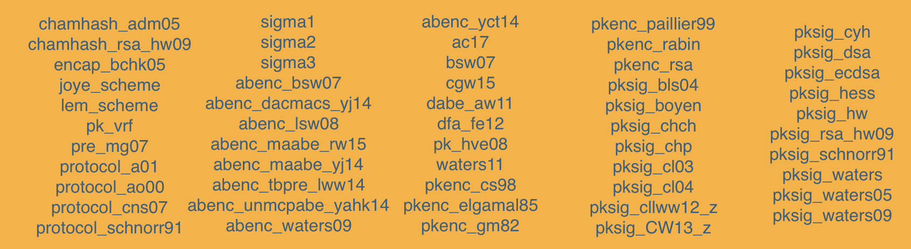
Charm-Cryptorypto
Charm is a Python based cryptography development framework for rapid prototyping of advanced cryptographic systems. Basic cryptographic libraries that are commonly used are basically supported, including symmetric encryption, message digests, digital signatures, and so on.
https://jhuisi.github.io/charm/schemes.html

Slide 10
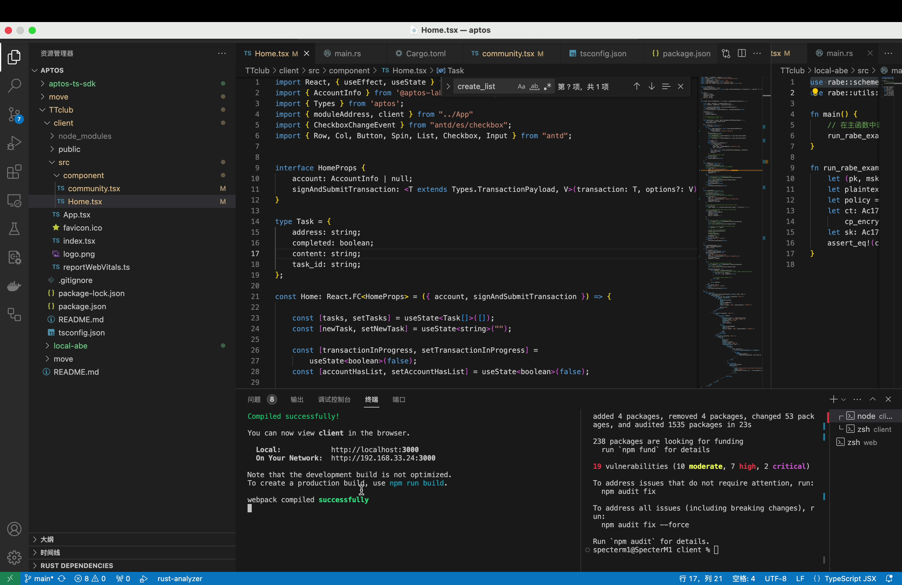
Homepage

Slide 11




Team Presentation
Specter CEO
Barron CS
Dick CTO
Wendy CMO

